Slide 1
Logistic Regression

Slide 2
Binary Target

Slide 3
Binary Target
Assume a data set has a BINARY Target Variable: 0 or 1
Linear (OLS) Regression cannot be used to predict this target because:
Errors won’t be normally distributed
Probability value from OLS regression can take on values > 100% or < 0%
Even if the Predicted value is truncated, the predictions are usually not good

Slide 4
Binary Target
Logistic Regression
Uses Maximum Likelihood algorithm
Predicts LOG-ODDS (“LOGIT”) of target (value can range from +/- Infinity)
Logit can be converted to a Probability Score ranging from 0% to 100%
Most common method of dealing with Binary Targets
Easy to write scoring code
Easy to interpret coefficients

Slide 5
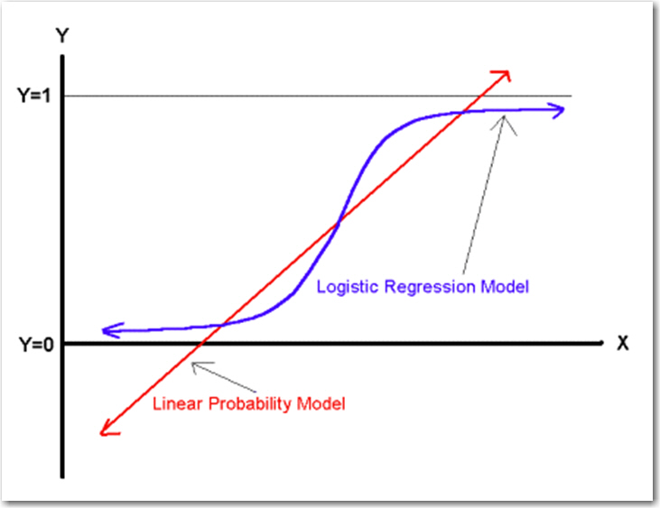
Binary Target

Slide 6
Binary Target
Probit Regression
Uses Maximum Likelihood algorithm
Predicts a “Z-Score” of target (value can range from +/- Infinity)
Z-Score be can be converted to a Probability Score ranging from 0% to 100%
Z-Score is transformed into Probability: Cumulative Density Function of Normal Curve
Not as common as Logistic Regression
People are exposed to Logistic more that Probit, so more familiar with Logistic
Probit gives similar accuracy, so no reason to change
More difficult to interpret the coefficients of Probit model
No simple formula to convert Z-Score to Probability … luckily many languages like SAS do have a function to convert Z-Scores to Probability).
For a given PROBABILITY, the LOGIT and Z-SCORE are almost identical:

Slide 7
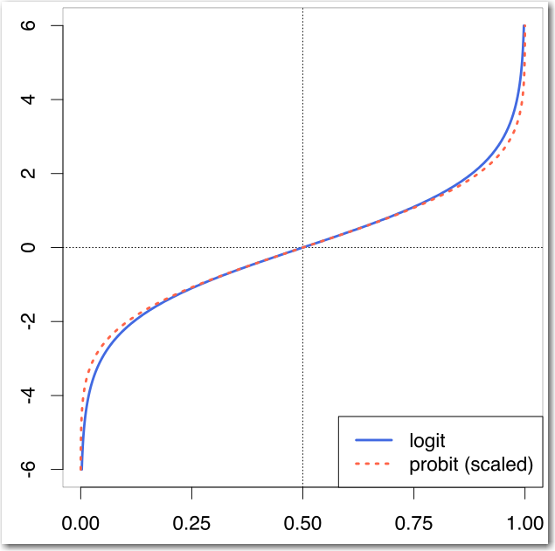
Binary Target

Slide 8
Logistic Regression
Overview

Slide 9
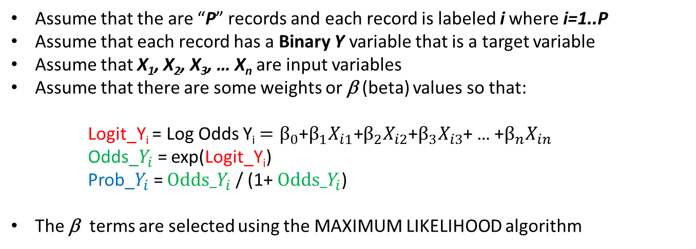
Logistic Regression Review
Assume that the are “P” records and each record is labeled i where i=1..P
Assume that each record has a Binary Y variable that is a target variable
Assume that X₁, X₂, X₃, … X_{n} are input variables
Assume that there are some weights or β (beta) values so that:
Logit_Y_{i} = Log Odds Y_{i} $=β_{0}$+$β_{1}X_{i1}\text{+}β_{2}X_{i2}$+$β_{3}X_{i3}$+ … +$β_{n}X_{in}$
Odds_$Y_{i}$= exp(Logit_Y_{i})
Prob_$Y_{i}$= $Odds_Y_{i}$ / (1+ $Odds_Y_{i}$)
The β terms are selected using the MAXIMUM LIKELIHOOD algorithm

Slide 10

Logistic Regression Review
EXAMPLE:
Assume:
X6 = 20
X8 = 35.3
Logit_Y_{i} = $\text{−327.0 + 20.5993∗}\text{X}\text{6 − 2.04}\text{14∗}\text{X}\text{8}$
Odds_$Y_{i}$= exp(Logit_Y_{i})
Prob_$Y_{i}$= $Odds_Y_{i}$ / (1+ $Odds_Y_{i}$)

Slide 11

Logistic Regression Review
EXAMPLE:
Assume:
X6 = 20
X8 = 35.3
Logit_Y_{i} = $\text{−327.0 + 20.5993∗}\text{20}\text{ − 2.0414∗}$35.3
Odds_$Y_{i}$= exp(Logit_Y_{i})
Prob_$Y_{i}$= $Odds_Y_{i}$ / (1+ $Odds_Y_{i}$)

Slide 12

Logistic Regression Review
EXAMPLE:
Assume:
X6 = 20
X8 = 35.3
12.925 = $\text{−327.0 + 20.5993∗}\text{20}\text{ − 2.0414∗}$35.3
Odds_$Y_{i}$= exp(Logit_Y_{i})
Prob_$Y_{i}$= $Odds_Y_{i}$ / (1+ $Odds_Y_{i}$)

Slide 13

Logistic Regression Review
EXAMPLE:
Assume:
X6 = 20
X8 = 35.3
12.925 = $\text{−327.0 + 20.5993∗}\text{20}\text{ − 2.0414∗}$35.3
Odds_$Y_{i}$= exp(12.925)
Prob_$Y_{i}$= $Odds_Y_{i}$ / (1+ $Odds_Y_{i}$)

Slide 14

Logistic Regression Review
EXAMPLE:
Assume:
X6 = 20
X8 = 35.3
12.925 = $\text{−327.0 + 20.5993∗}\text{20}\text{ − 2.0414∗}$35.3
410273.8 = exp(12.925)
Prob_$Y_{i}$= $Odds_Y_{i}$ / (1+ $Odds_Y_{i}$)

Slide 15

Logistic Regression Review
EXAMPLE:
Assume:
X6 = 20
X8 = 35.3
12.925 = $\text{−327.0 + 20.5993∗}\text{20}\text{ − 2.0414∗}$35.3
410273.8 = exp(12.925)
Prob_$Y_{i}$=410273.8/ (1+410273.8)

Slide 16

Logistic Regression Review
EXAMPLE:
Assume:
X6 = 20
X8 = 35.3
12.925 = $\text{−327.0 + 20.5993∗}\text{20}\text{ − 2.0414∗}$35.3
410273.8 = exp(12.925)
0.999998=410273.8/ (1+410273.8)

Slide 17

Logistic Regression Review
EXAMPLE:
Assume:
X6 = 20
X8 = 35.3
12.925 = $\text{−327.0 + 20.5993∗}\text{20}\text{ − 2.0414∗}$35.3
410273.8 = exp(12.925)
0.999998=410273.8/ (1+410273.8)
PROB that Y=1 is 99.9998%

Slide 18
Logistic Regression
Example

Slide 19
Logistic Regression: Example
This example is taken from the previously mentioned Draper and Smith reference.
The data describes monthly steam usage in a manufacturing plant
Y_Temp Monthly use of steam
Y 1: Y_Temp > 10
0: Y_Temp <= 10
X6 Operating days per month
X8 Average temperature in degrees Fahrenheit
NOTE: Draper and Smith named their variables X6 and X8, don’t worry about that. The names of the variables are not important and don’t affect the formula.
Raw Data is given on the following slide.
SAS Code is provided to read data into SAS

Slide 20
Logistic Regression: Example
Raw Steam Usage Data
 | X6 | X8 | Y
1 | 20 | 35.3 | 10.98
2 | 20 | 29.7 | 11.13
3 | 23 | 30.8 | 12.51
4 | 20 | 58.8 | 8.4
5 | 21 | 61.4 | 9.27
6 | 22 | 71.3 | 8.73
7 | 11 | 74.4 | 6.36
8 | 23 | 76.7 | 8.5
9 | 21 | 70.7 | 7.82
10 | 20 | 57.5 | 9.14
11 | 20 | 46.4 | 8.24
12 | 21 | 28.9 | 12.19
13 | 21 | 28.1 | 11.88
14 | 19 | 39.1 | 9.57
15 | 23 | 46.8 | 10.94
16 | 20 | 48.5 | 9.58
17 | 22 | 59.3 | 10.09
18 | 22 | 70 | 8.11
19 | 11 | 70 | 6.83
20 | 23 | 74.5 | 8.88
21 | 20 | 72.1 | 7.68
22 | 21 | 58.1 | 8.47
23 | 20 | 44.6 | 8.86
24 | 20 | 33.4 | 10.36
25 | 22 | 28.6 | 11.08

Slide 21
Logistic Regression: Example
SAS Data Step to read in raw data
data TEMPFILE;
input X6 X8 YTEMP;
Y = (YTEMP>10);
drop YTEMP;
datalines;
20 35.3 10.98
20 29.7 11.13
23 30.8 12.51
20 58.8 8.40
21 61.4 9.27
22 71.3 8.73
11 74.4 6.36
23 76.7 8.50
21 70.7 7.82
20 57.5 9.14
20 46.4 8.24
21 28.9 12.19
21 28.1 11.88
19 39.1 9.57
23 46.8 10.94
20 48.5 9.58
22 59.3 10.09
22 70.0 8.11
11 70.0 6.83
23 74.5 8.88
20 72.1 7.68
21 58.1 8.47
20 44.6 8.86
20 33.4 10.36
22 28.6 11.08
;
run;

Slide 22
Logistic Regression: Example
NOTE: In the SAS data step, the Y = (YTEMP>10); command will return a 1 when YTEMP is larger than 10, otherwise the value will be 0.
data TEMPFILE;
input X6 X8 YTEMP;
Y = (YTEMP>10);
drop YTEMP;
datalines;
20 35.3 10.98
20 29.7 11.13
23 30.8 12.51
20 58.8 8.40
61.4 9.27
...

Slide 23
Logistic Regression: Example
After the data has been read in and transformed, the data set looks like this:
 | X6 | X8 | Y
1 | 20 | 35.3 | 1
2 | 20 | 29.7 | 1
3 | 23 | 30.8 | 1
4 | 20 | 58.8 | 0
5 | 21 | 61.4 | 0
6 | 22 | 71.3 | 0
7 | 11 | 74.4 | 0
8 | 23 | 76.7 | 0
9 | 21 | 70.7 | 0
10 | 20 | 57.5 | 0
11 | 20 | 46.4 | 0
12 | 21 | 28.9 | 1
13 | 21 | 28.1 | 1
14 | 19 | 39.1 | 0
15 | 23 | 46.8 | 1
16 | 20 | 48.5 | 0
17 | 22 | 59.3 | 1
18 | 22 | 70 | 0
19 | 11 | 70 | 0
20 | 23 | 74.5 | 0
21 | 20 | 72.1 | 0
22 | 21 | 58.1 | 0
23 | 20 | 44.6 | 0
24 | 20 | 33.4 | 1
25 | 22 | 28.6 | 1

Slide 24
Logistic Regression: Example
SAS has many procs that can do Logistic Regression. Here are three:
proc logistic data=TEMPFILE;
model Y(ref="0") = X6 X8;
run;
quit;
proc probit data=TEMPFILE;
model Y(ref="0") = X6 X8 /d=logistic;
run;
quit;
proc genmod data=TEMPFILE descending;
model Y = X6 X8 /dist=binomial link=logit;
run;
Usually, three different PROCS doing the same thing should give the same result …
However ….

Slide 25
Logistic Regression: Example
The data set is small and it is perfectly separable. Therefore, there are an infinite number of solutions that will separate the “1” and “0” values. Notice that the error term (“log likelihood”) for all three models is close to zero.
Therefore, even though there are different solutions, all of these are correct.
For more complex models, the three approaches would yield similar results.

Slide 26
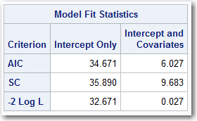
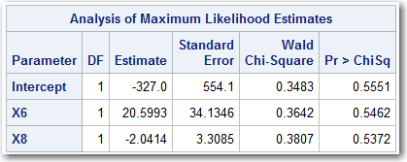
Logistic Regression: Example
PROC LOGISTIC:
proc logistic data=TEMPFILE;
model Y(ref="0") = X6 X8;
run;
quit;
Error Terms
Beta Values

Slide 27
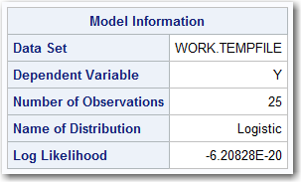
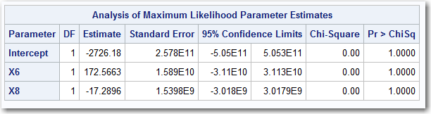
Logistic Regression: Example
PROC PROBIT WITH LOGISTIC OPTION:
proc probit data=TEMPFILE;
model Y(ref="0") = X6 X8 /d=logistic;
run;
quit;
Error Terms
Beta Values

Slide 28
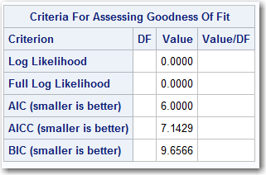
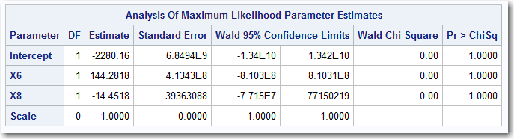
Logistic Regression: Example
PROC GENMOD WITH LOGISTIC OPTION:
proc genmod data=TEMPFILE descending;
model Y = X6 X8 /dist=binomial link=logit;
run;
Error Terms
Beta Values

Slide 29
Logistic Regression: Example
When the parameter from all three models are put into a data step to score data, they all give similar results:
data SCOREFILE;
set TEMPFILE;
TEMP = -327.0 + 20.5993*X6 - 2.0414*X8;
TEMP = exp(TEMP);
if missing(TEMP) then TEMP = 999999;
P_LOGISTIC = TEMP / (1+TEMP);
TEMP = -2726.18 + 172.5663*X6 - 17.2896*X8;
TEMP = exp(TEMP);
if missing(TEMP) then TEMP = 999999;
P_PROBIT = TEMP / (1+TEMP);
TEMP = -2280.16 + 144.2818*X6 - 14.4518*X8;
TEMP = exp(TEMP);
if missing(TEMP) then TEMP = 999999;
P_GENMOD = TEMP / (1+TEMP);
drop TEMP;
run;

Slide 30
Logistic Regression: Example
Obs | X6 | X8 | Y | P_LOGISTIC | P_PROBIT | P_GENMOD
1 | 20 | 35.3 | 1 | 1 | 1 | 1
2 | 20 | 29.7 | 1 | 1 | 1 | 1
3 | 23 | 30.8 | 1 | 1 | 1 | 1
4 | 20 | 58.8 | 0 | 0 | 0 | 0
5 | 21 | 61.4 | 0 | 0 | 0 | 0
6 | 22 | 71.3 | 0 | 0 | 0 | 0
7 | 11 | 74.4 | 0 | 0 | 0 | 0
8 | 23 | 76.7 | 0 | 0.00006 | 0 | 0
9 | 21 | 70.7 | 0 | 0 | 0 | 0
10 | 20 | 57.5 | 0 | 0 | 0 | 0
11 | 20 | 46.4 | 0 | 0.00006 | 0 | 0
12 | 21 | 28.9 | 1 | 1 | 1 | 1
13 | 21 | 28.1 | 1 | 1 | 1 | 1
14 | 19 | 39.1 | 0 | 0 | 0 | 0
15 | 23 | 46.8 | 1 | 1 | 1 | 1
16 | 20 | 48.5 | 0 | 0 | 0 | 0
17 | 22 | 59.3 | 1 | 0.99412 | 1 | 1
18 | 22 | 70 | 0 | 0 | 0 | 0
19 | 11 | 70 | 0 | 0 | 0 | 0
20 | 23 | 74.5 | 0 | 0.00496 | 0 | 0
21 | 20 | 72.1 | 0 | 0 | 0 | 0
22 | 21 | 58.1 | 0 | 0 | 0 | 0
23 | 20 | 44.6 | 0 | 0.00233 | 0 | 0
24 | 20 | 33.4 | 1 | 1 | 1 | 1
25 | 22 | 28.6 | 1 | 1 | 1 | 1

Slide 31
Probit Regression
Example

Slide 32
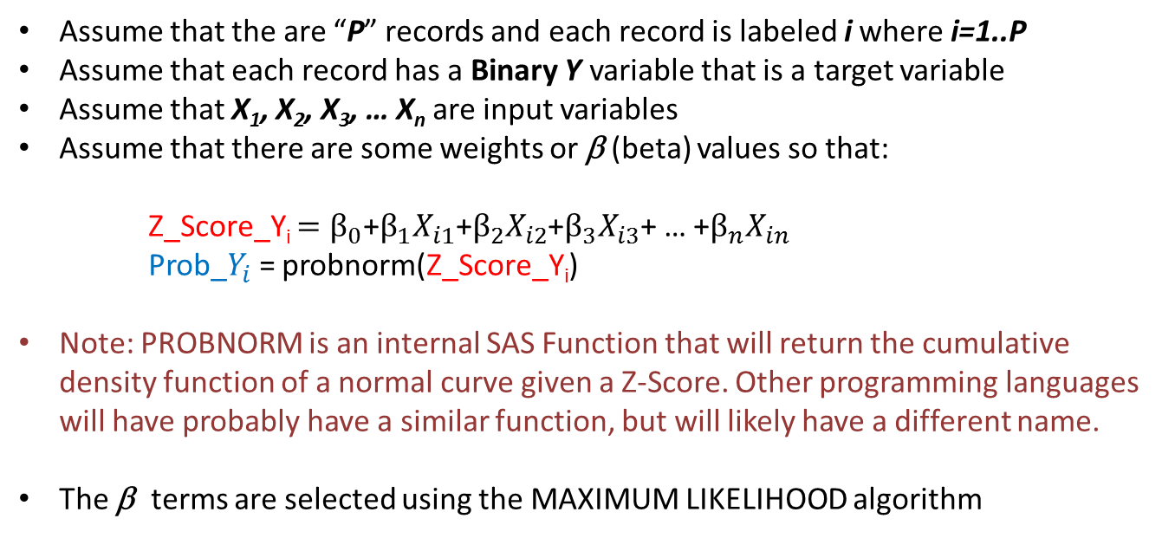
Probit Regression Review
Assume that the are “P” records and each record is labeled i where i=1..P
Assume that each record has a Binary Y variable that is a target variable
Assume that X₁, X₂, X₃, … X_{n} are input variables
Assume that there are some weights or β (beta) values so that:
Z_Score_Y_{i} $=β_{0}$+$β_{1}X_{i1}\text{+}β_{2}X_{i2}$+$β_{3}X_{i3}$+ … +$β_{n}X_{in}$
Prob_$Y_{i}$= probnorm(Z_Score_Y_{i})
Note: PROBNORM is an internal SAS Function that will return the cumulative density function of a normal curve given a Z-Score. Other programming languages will have probably have a similar function, but will likely have a different name.
The β terms are selected using the MAXIMUM LIKELIHOOD algorithm

Slide 33
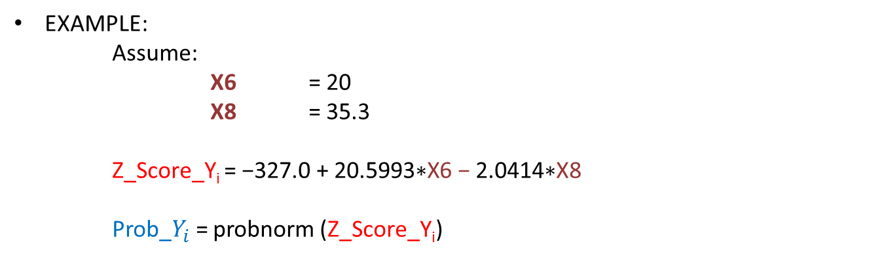
Probit Regression Review
EXAMPLE:
Assume:
X6 = 20
X8 = 35.3
Z_Score_Y_{i} = $\text{−327.0 + 20.5993∗}\text{X}\text{6 − 2.0414∗}\text{X}\text{8}$
Prob_$Y_{i}$= probnorm (Z_Score_Y_{i})

Slide 34
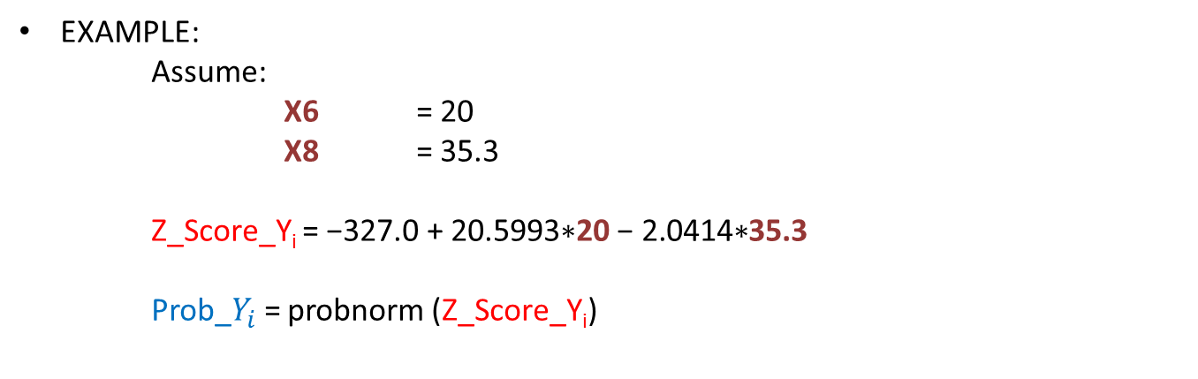
Probit Regression Review
EXAMPLE:
Assume:
X6 = 20
X8 = 35.3
Z_Score_Y_{i} = $\text{−327.0 + 20.5993∗}\text{20}\text{ − 2.0414∗}$35.3
Prob_$Y_{i}$= probnorm (Z_Score_Y_{i})

Slide 35
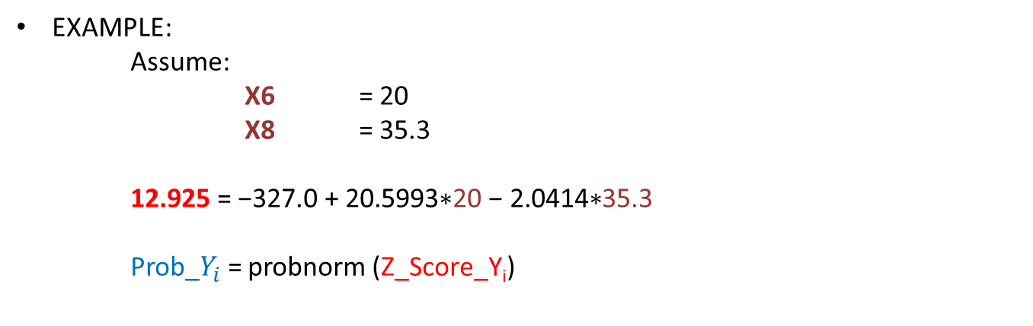
Probit Regression Review
EXAMPLE:
Assume:
X6 = 20
X8 = 35.3
12.925 = $\text{−327.0 + 20.5993∗}\text{20}\text{ − 2.0414∗}$35.3
Prob_$Y_{i}$= probnorm (Z_Score_Y_{i})

Slide 36
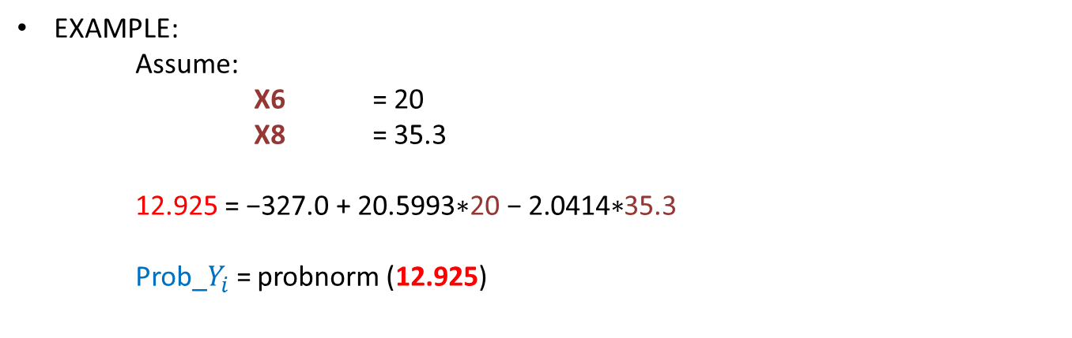
Probit Regression Review
EXAMPLE:
Assume:
X6 = 20
X8 = 35.3
12.925 = $\text{−327.0 + 20.5993∗}\text{20}\text{ − 2.0414∗}$35.3
Prob_$Y_{i}$= probnorm (12.925)

Slide 37
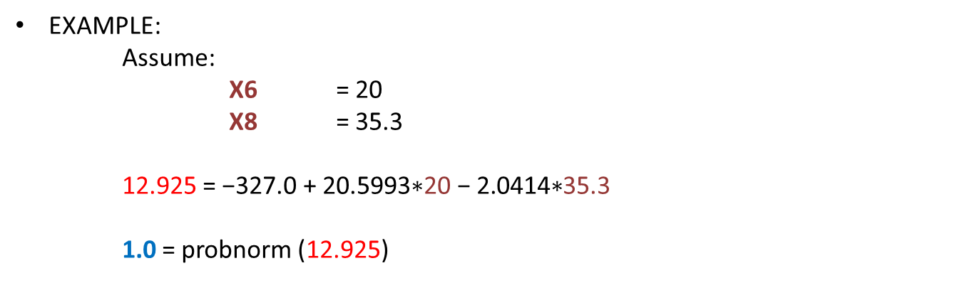
Probit Regression Review
EXAMPLE:
Assume:
X6 = 20
X8 = 35.3
12.925 = $\text{−327.0 + 20.5993∗}\text{20}\text{ − 2.0414∗}$35.3
1.0 = probnorm (12.925)

Slide 38

Probit Regression Review
EXAMPLE:
Assume:
X6 = 20
X8 = 35.3
12.925 = $\text{−327.0 + 20.5993∗}\text{20}\text{ − 2.0414∗}$35.3
1.0 = probnorm (12.925)
PROB that Y=1 is 100%

Slide 39
Probit Regression : Example
SAS has many procs that can do Probit Regression. Here are two:
proc probit data=TEMPFILE;
model Y(ref="0") = X6 X8;
run;
quit;
proc genmod data=TEMPFILE descending;
model Y = X6 X8 /dist=binomial link=probit;
run;
Usually, both different PROCS doing the same thing should give the same result …
However …. As with LOGISTIC Regression:
The data set is small and it is perfectly separable. Therefore, there are an infinite number of solutions that will separate the “1” and “0” values.
Therefore, even though there are different solutions, all of these are correct.
For more complex models, both approaches would yield similar results.

Slide 40
Probit Regression : Example
The data set is small and it is perfectly separable. Therefore, there are an infinite number of solutions that will separate the “1” and “0” values. Notice that the error term (“log likelihood”) for both of these models is close to zero.
Therefore, even though there are different solutions, both of these are correct.
For more complex models, both of these approaches would yield similar results.

Slide 41
Probit Regression : Example
When the parameter from both models are put into a data step to score data, they all give similar results:
data SCOREFILE;
set TEMPFILE;
TEMP = -569.331 + 36.0494*X6 -3.6142*X8;
P_PROBIT = probnorm(TEMP);
TEMP = -501.599 + 31.7541*X6 - 3.1829*X8;
P_GENMOD = probnorm(TEMP);
drop TEMP;
run;

Slide 42
Probit Regression : Example
Obs | X6 | X8 | Y | P_PROBIT | P_GENMOD
1 | 20 | 35.3 | 1 | 1 | 1
2 | 20 | 29.7 | 1 | 1 | 1
3 | 23 | 30.8 | 1 | 1 | 1
4 | 20 | 58.8 | 0 | 0 | 0
5 | 21 | 61.4 | 0 | 0 | 0
6 | 22 | 71.3 | 0 | 0 | 0
7 | 11 | 74.4 | 0 | 0 | 0
8 | 23 | 76.7 | 0 | 0 | 0
9 | 21 | 70.7 | 0 | 0 | 0
10 | 20 | 57.5 | 0 | 0 | 0
11 | 20 | 46.4 | 0 | 0 | 0
12 | 21 | 28.9 | 1 | 1 | 1
13 | 21 | 28.1 | 1 | 1 | 1
14 | 19 | 39.1 | 0 | 0 | 0
15 | 23 | 46.8 | 1 | 1 | 1
16 | 20 | 48.5 | 0 | 0 | 0
17 | 22 | 59.3 | 1 | 1 | 1
18 | 22 | 70 | 0 | 0 | 0
19 | 11 | 70 | 0 | 0 | 0
20 | 23 | 74.5 | 0 | 0 | 0
21 | 20 | 72.1 | 0 | 0 | 0
22 | 21 | 58.1 | 0 | 0 | 0
23 | 20 | 44.6 | 0 | 0 | 0
24 | 20 | 33.4 | 1 | 1 | 1
25 | 22 | 28.6 | 1 | 1 | 1

